Slide 1
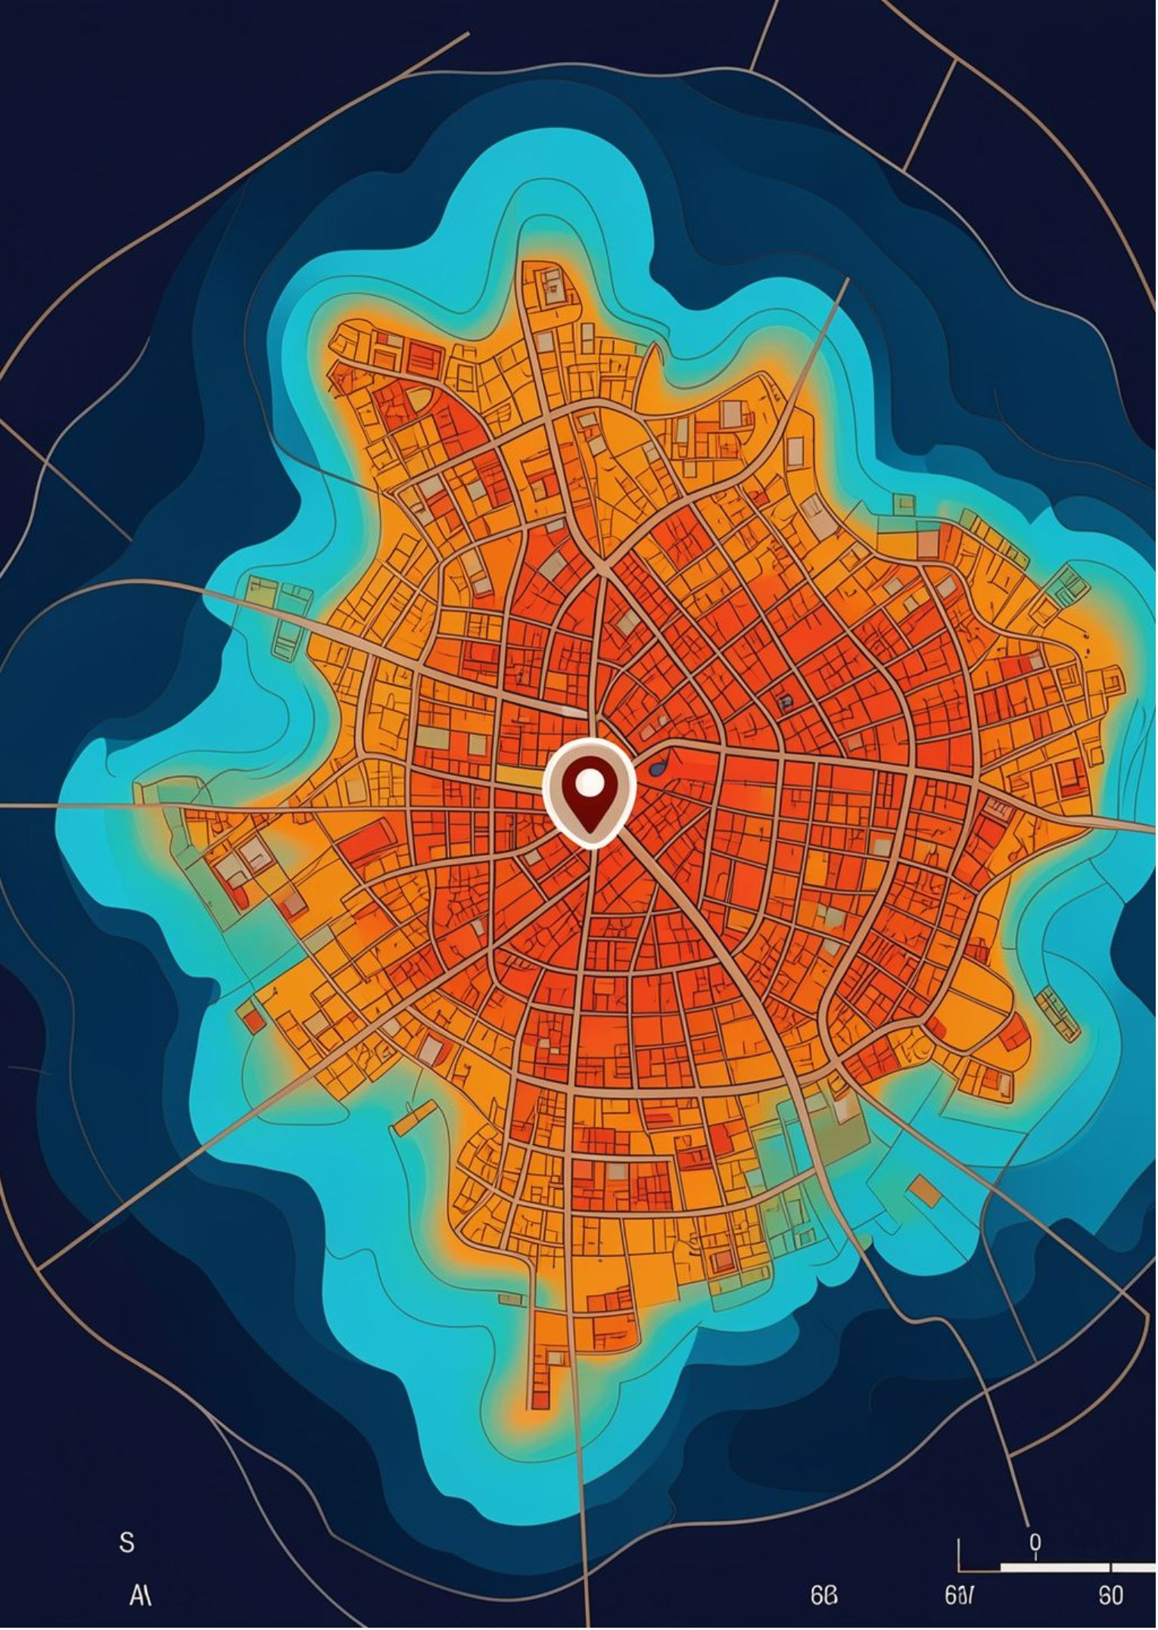
TF-141 · B.TECH — SEMESTER III
HEATSHIELD
Urban Heat Exposure Analysis and Cooling Intelligence Platform
Phase-1 EDA Project Evaluation | MIT Vishwaprayag University
Solapur, Maharashtra
FURQAN BAGWAN
AMAN SHAIKH
BHAVIN SHANKUR
PRN: SCFU425004
Frontend Development
PRN: SCFU425013
EDA & Data Visualization (EDADV)
PRN: SCFU425014
Backend Development & Database

Slide 2
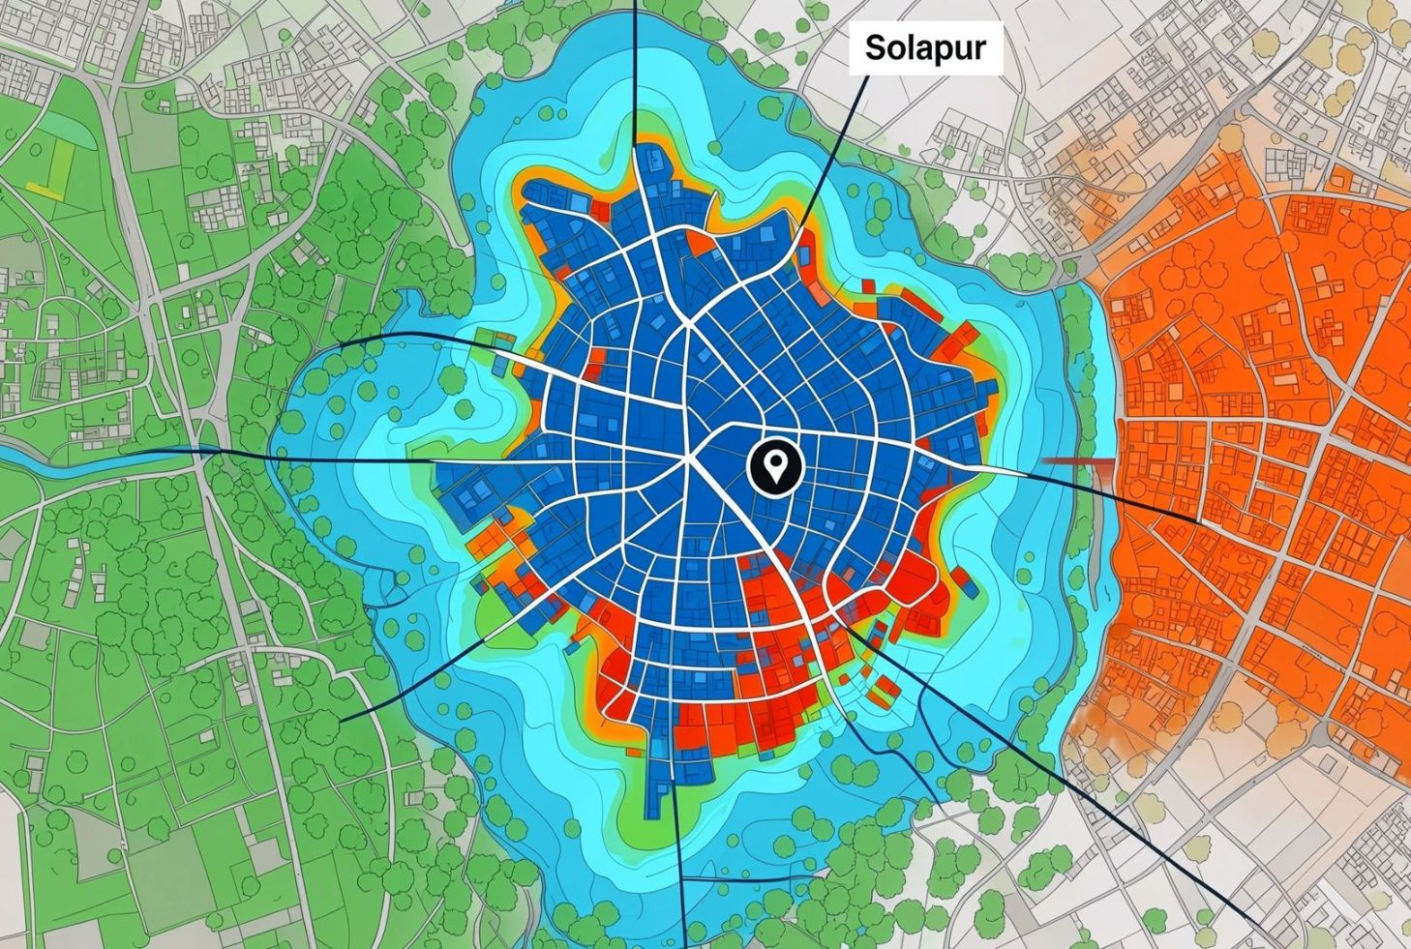
THE PROBLEM
Understanding the Urban Heat Challenge
Research question: How can environmental, geographical, and land-surface data be explored to understand spatial variations in urban heat exposure and identify areas that may require cooling-oriented planning in Solapur?
Objective: Build a data-driven foundation for cooling-intelligence exploration.
Conceptual illustration, not a measured satellite heat map.
Built-up surfaces
Green space
Thermal measures
Planning signal
Concrete and roads vary across urban zones.
Vegetation and water create different surface conditions.
Air temperature and land-surface temperature capture different conditions.
Spatial and temporal variation requires structured exploration.
2

Slide 3
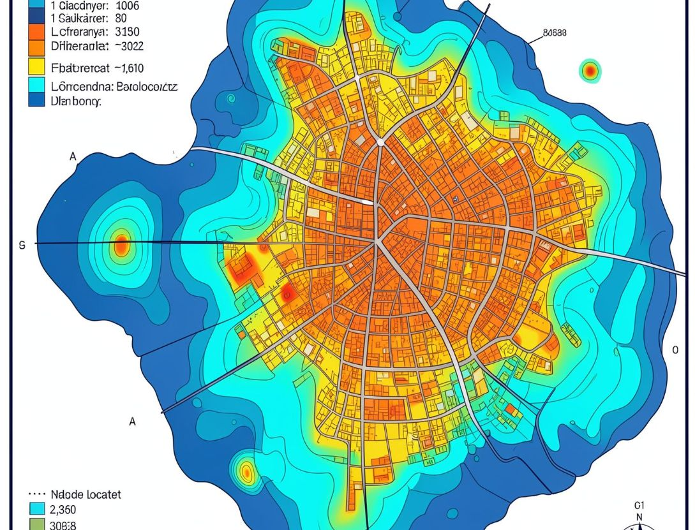




DATASET FOUNDATION
Our Dataset — The Foundation of HeatShield
Heat Shield Master Dataset.csv
150,000
57
100
records
attributes
monitoring locations
Solapur, Maharashtra, India · 2021–2025 · 9 urban morphology categories · CSV format
SYNTHETIC ACADEMIC SIMULATION DATA
Geographical attributes are representative of Solapur, but records are not verified government meteorological measurements.
Identity & time
Geography
Atmosphere
Surface & planning
record_id · location_id · observation_datetime · season
latitude · longitude · location_name · zone_type · elevation
air temperature · humidity · wind · solar radiation · precipitation
LST · NDVI · NDBI · NDWI · vegetation · imperviousness · cooling priority
3

Slide 4
DATA STRUCTURE
Exploring the Data Structure
FEATURE SCHEMA
150,000
Feature | Type | Meaning
air_temperature_c | numeric | ambient temperature (°C)
land_surface_temperature_c | numeric | LST (°C)
relative_humidity_pct | numeric | humidity (%)
NDVI / NDBI | index | environmental indices
latitude / longitude | numeric | coordinates (degrees)
rows · individual synthetic observations tied to a location and timestamp
57
columns · geography, atmosphere, land surface, and heat-related indicators
Data types: numeric measures and indices · categorical descriptors · date/time fields · Boolean indicators
8,550,000
data cells across 100 locations and 9 urban zone categories
4

Slide 5
QUALITY & RELIABILITY
Assessing Dataset Quality and Reliability
0
Quality checks
Missing/null values checked across all columns.
Duplicate records, record-ID uniqueness, and repeated location–time combinations checked.
Numeric, categorical, date/time, and Boolean fields reviewed.
Temperature, humidity, environmental-index, and coordinate ranges checked.
Synthetic-data flag and academic-simulation disclosure retained.
missing cells reported in the audited master dataset
SYNTHETIC ACADEMIC SIMULATION
Zero missing values do not prove the dataset is error-free; distinguish literal categories such as “None” from actual nulls.
Initial handling: preserve the master dataset · investigate suspicious values before changing them · maintain consistent units and types · document transformations separately.
5

Slide 6
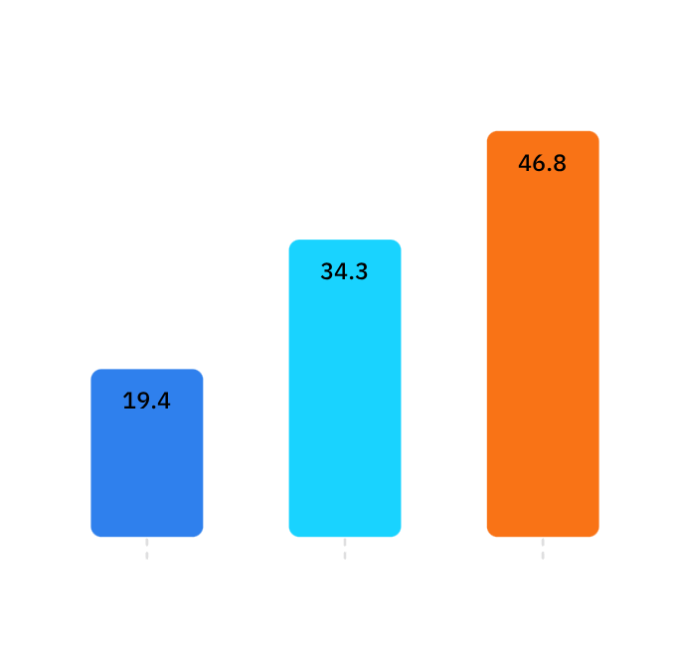
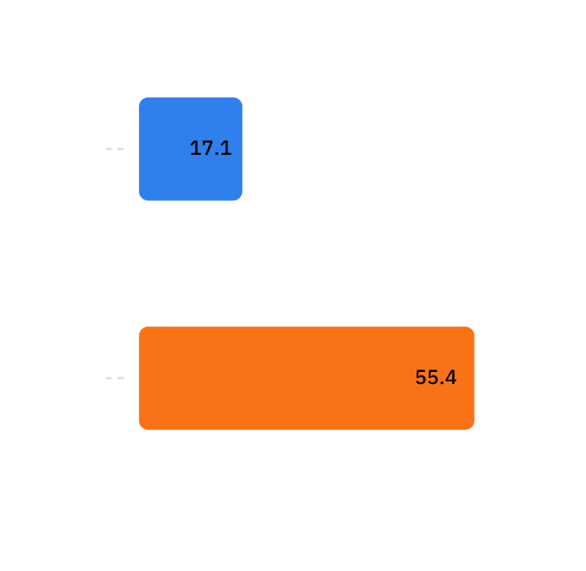
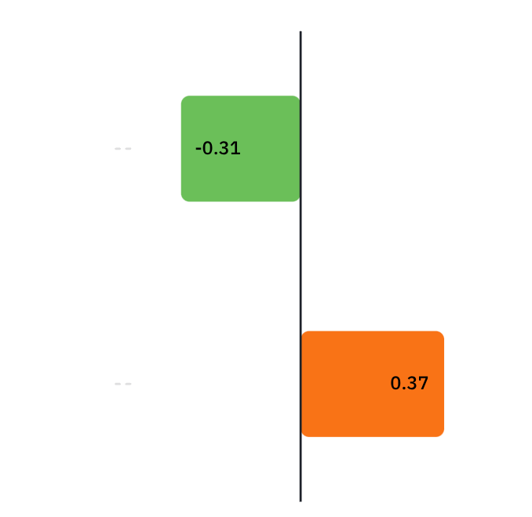
KEY EVIDENCE
What Does Our Dataset Reveal?
AIR TEMPERATURE
LAND-SURFACE TEMPERATURE
CORRELATION WITH LST
Approximately 19.35°C min · 34.28°C mean · 46.81°C max
Approximately 17.06°C–55.35°C
NDVI shows a negative descriptive association; NDBI shows a positive descriptive association.
PHASE 1 TAKEAWAY
These relationships do not establish causation.
A credible foundation for deeper spatial, comparative, and cooling-oriented exploration.
SYNTHETIC ACADEMIC SIMULATION
Not verified real-world Solapur weather observations. Further validation and statistical analysis required.
6

